Slide 1

Spring Boot

Slide 2
Agenda
What is Web Application Architecture
What is Spring Boot
Dependency Injection
Spring Beans
Bean Scopes
Spring Boot annotations

Slide 3
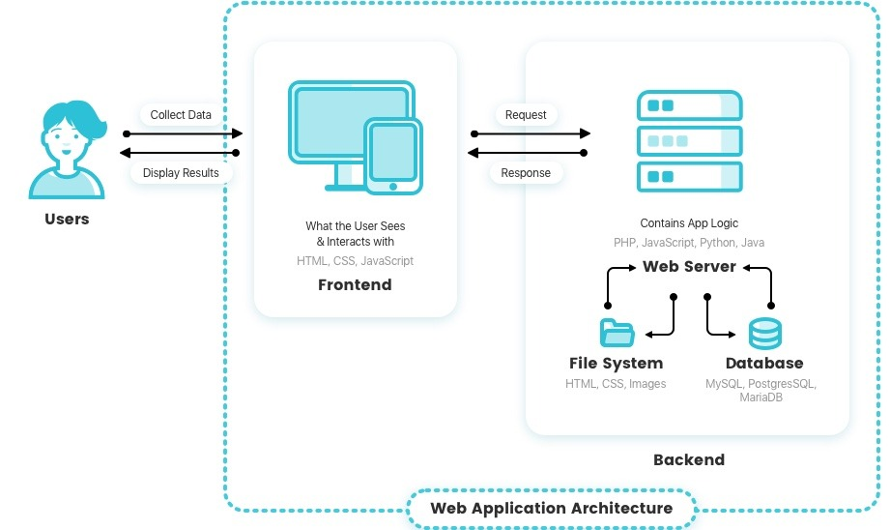
What is Web Application Architecture

Slide 4
We should use Spring Boot framework because:
The most popular Java framework for Back-end/API development.
The dependency injection approach is used in Spring Boot.
It contains powerful database transaction management capabilities.
It simplifies integration with other Java frameworks like JPA/Hibernate ORM, Struts, etc.
It reduces the cost and development time of the application.

Slide 5
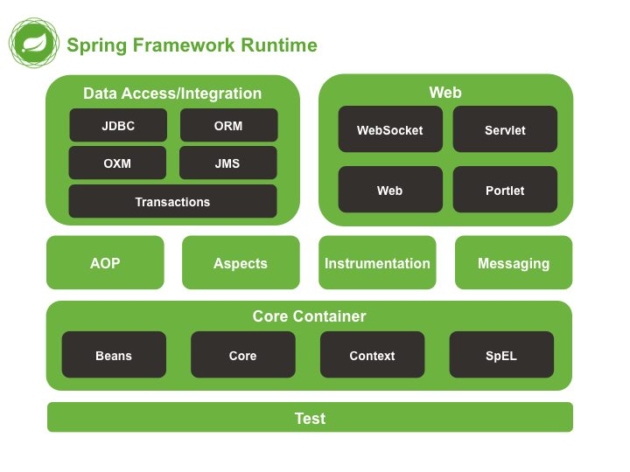
Spring Framework architecture

Slide 6
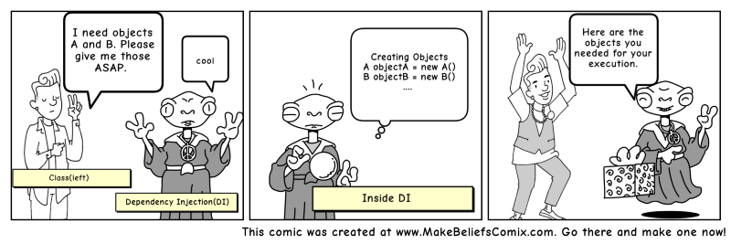
Dependency Injection (DI)

Slide 7
Dependency Injection
Benefits of using DI
Helps in Unit testing.
Boilerplate code is reduced, as initializing of dependencies is done by the injector component.
Extending the application becomes easier.
Helps to enable loose coupling, which is important in application programming.
Disadvantages of DI
It’s a bit complex to learn, and if overused can lead to management issues and other problems.
Many compile time errors are pushed to run-time.
Dependency injection frameworks are implemented with reflection or dynamic programming. This can hinder use of IDE automation, such as “find references”, “show call hierarchy” and safe refactoring.

Slide 8
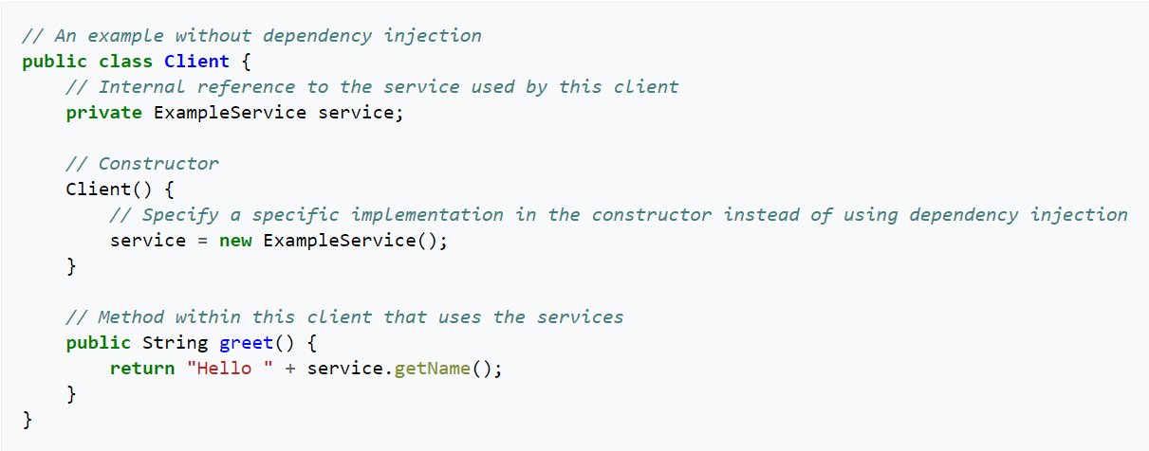
Let’s go with an example

Slide 9
Problems with previous example
Client class is responsible to initialize the example service and then use it. This leads to hard-coded dependency. If we want to switch to some other advanced service in the future, it will require code changes in Client class.
If we want to extend our application to provide an additional feature, then we would need to write another application for that. This will involve code changes in application classes and in client classes too.
Testing the application will be very difficult since our application is directly creating the service instance. There is no way we can mock these objects in our test classes.

Slide 10
DI types in Spring Boot
Constructor Injection
Setter Injection
Filed Injection

Slide 11
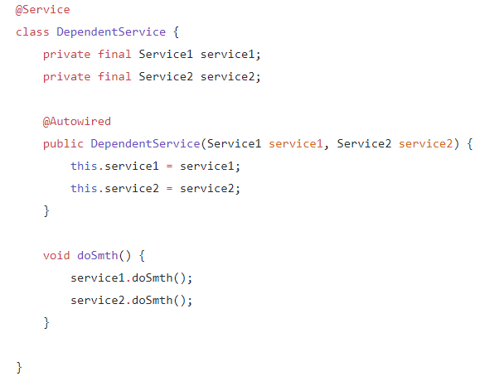
Constructor-Based Dependency Injection
Advantages
Constructed object is immutable and returned to the client in a fully initialized state.
An issue with a growing amount of dependencies is immediately visible with this approach. More dependencies bigger the constructor.
Can be combined with setter injection or field injection, constructor parameters indicate required dependencies, others — optional.
Disadvantages
No possibility to change object’s dependencies later — inflexibility.
Higher chance to have circular dependencies, so-called chicken-and-egg scenario.

Slide 12
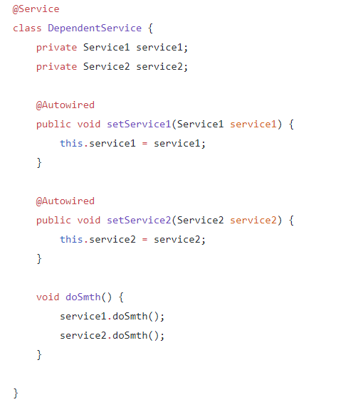
Setter-Based Dependency Injection
Advantages
Flexibility in dependency resolution or object reconfiguration, it can be done anytime. Plus, this freedom solves the circular dependency issue of constructor injection.
Disadvantages
Null checks are required, because dependencies may not be set at the moment.
Potentially more error-prone and less secure than constructor injection due to the possibility of overriding dependencies.a

Slide 13
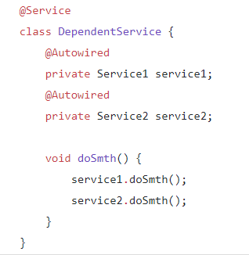
Field-Based Dependency Injection
Advantages
Easy to use, no constructors or setters required
Can be easily combined with the constructor and/or setter approach
Disadvantages
Less control over object instantiation. In order to instantiate the object of a class for a test, you will need either a Spring container configured or mock library — depends on the test you are writing.
A number of dependencies can reach dozens until you notice that something went wrong in your design.
No immutability — the same as for setter injection.

Slide 14
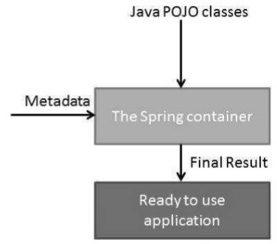
Spring IoC Containers
BeanFactory container
ApplicationContext container
The Spring IoC container is at the core of the Spring Framework. The container will create the objects, wire them together, configure them, and manage their complete life cycle from creation till destruction. The Spring container uses dependency injection (DI) to manage the components that make up an application.

Slide 15
What is a Spring Bean?
Here's a definition of beans in the Spring Framework documentation:
In Spring, the objects that form the backbone of your application and that are managed by the Spring IoC container are called beans. A bean is an object that is instantiated, assembled, and otherwise managed by a Spring IoC container.

Slide 16
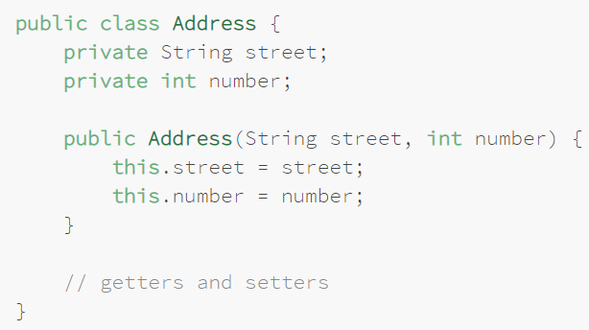
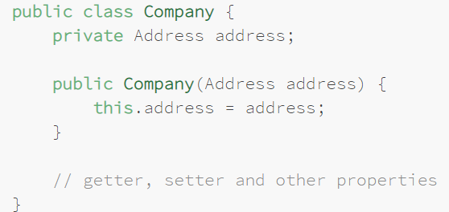
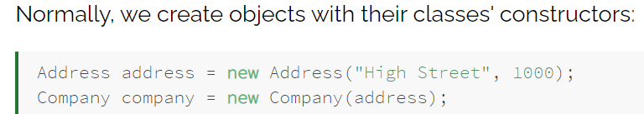
Spring Bean in action

Slide 17
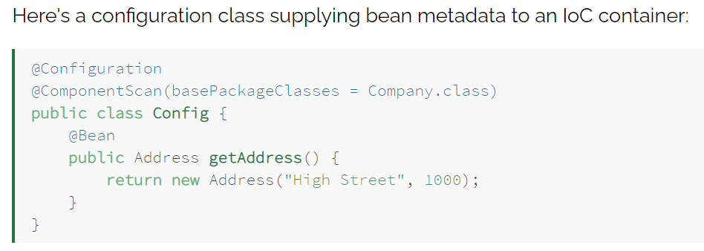
Bean configuration
The configuration class produces a bean of type Address. It also carries the @ComponentScan annotation, which instructs the container to looks for beans in the package containing the Company class.
When a Spring IoC container constructs objects of those types, all the objects are called Spring beans as they are managed by the IoC container.

Slide 18
Bean Life Cycle
Spring bean factory is responsible for managing the life cycle of beans created through spring container.
Spring bean factory controls the creation and destruction of beans. To execute some custom code, it provides the callback methods which can be categorized broadly in two groups:
Post-initialization callback methods
Pre-destruction callback methods

Slide 19
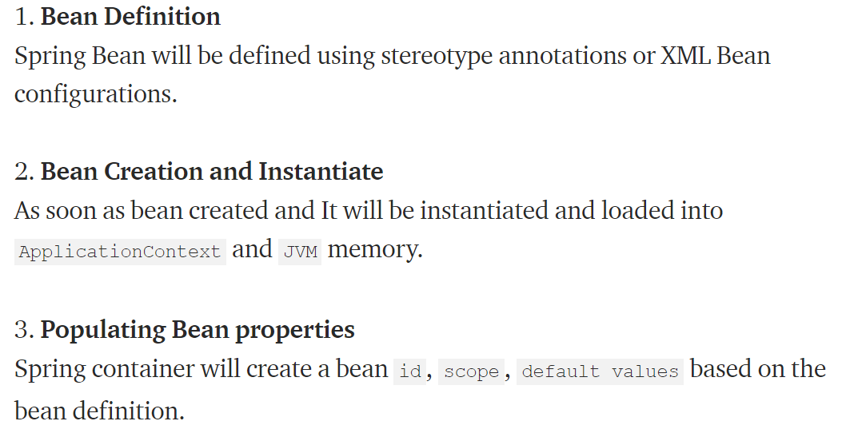
Life Cycle steps

Slide 20
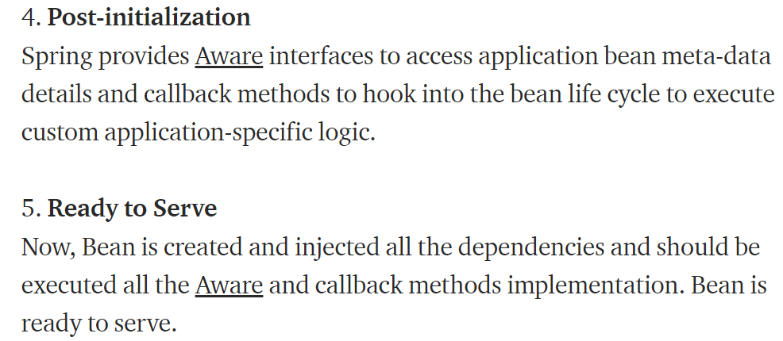
Life Cycle steps

Slide 21
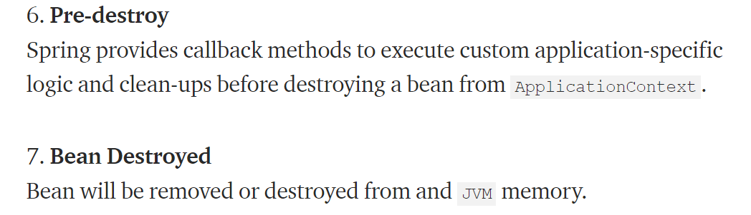
Life Cycle steps

Slide 22
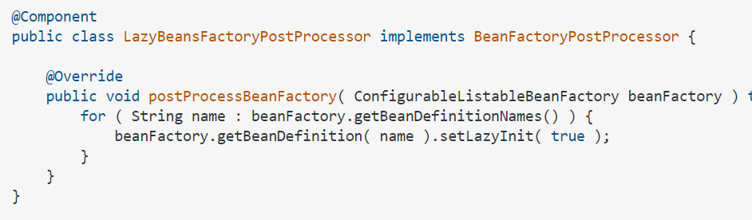
Initialization in Spring
By default in Spring, all the defined beans, and their dependencies, are created when the application context is created. In contrast, when we configure a bean with lazy initialization, the bean will only be created, and its dependencies injected, once they're needed.
This essentially puts the @Lazy annotation on all your @Component and @Services.

Slide 23
Effects of Lazy Initialization
Enabling lazy initialization in the whole application could produce both positive and negative effects.
Let's talk about some of these, as they're described in the official announcement of the new functionality:
Lazy initialization may reduce the number of beans created when the application is starting – therefore, we can improve the startup time of the application
As none of the beans are created until they are needed, we could mask issues, getting them in run time instead of startup time
The issues can include out of memory errors, misconfigurations, or class-definition-found errors
Also, when we're in a web context, triggering bean creation on demand will increase the latency of HTTP requests – the bean creation will affect only the first request, but this may have a negative impact in load-balancing and auto-scaling.

Slide 24
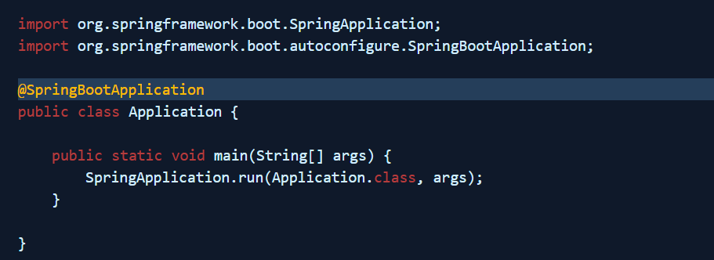
The entry point in Boot Application
The java class annotated with @SpringBootApplication is the main class of a Spring Boot application and application starts from here.
The shortcut @SpringBootApplication annotation is equivalent to using @Configuration, @EnableAutoConfiguration, and @ComponentScan and will pick up all config classes in or bellow the package where the class is defined.

Slide 25
Spring Annotations
The Java Programming language provided support for Annotations from Java 5.0. Leading Java frameworks were quick to adopt annotations and the Spring Framework started using annotations from the release 2.5. Due to the way they are defined, annotations provide a lot of context in their declaration.
Prior to annotations, the behavior of the Spring Framework was largely controlled through XML configuration. Today, the use of annotations provide us tremendous capabilities in how we configure the behaviors of the Spring Framework.

Slide 26
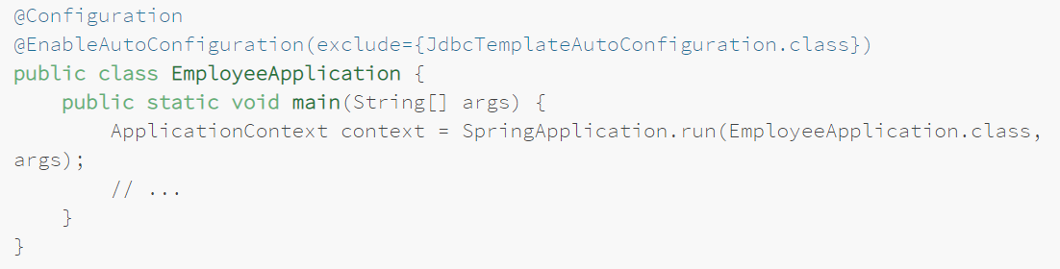
@EnableAutoConfiguration
The @EnableAutoConfiguration annotation enables Spring Boot to auto-configure the application context. Therefore, it automatically creates and registers beans based on both the included jar files in the classpath and the beans defined by us.
The package of the class declaring the @EnableAutoConfiguration annotation is considered as the default. Therefore, we should always apply the @EnableAutoConfiguration annotation in the root package so that every sub-packages and class can be examined:
We can use exclude to disable a list of classes that we do not want to be auto-configured:

Slide 27
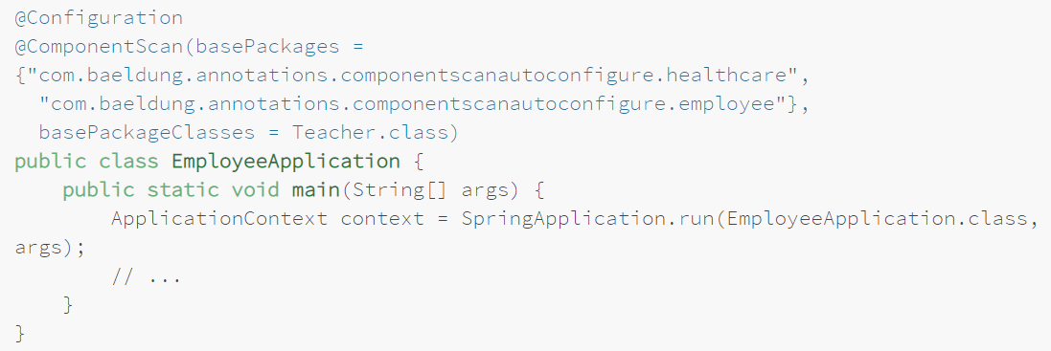
@ComponentScan
While developing an application, we need to tell the Spring framework to look for Spring-managed components. @ComponentScan enables Spring to scan for things like configurations, controllers, services, and other components we define.
Spring can also start scanning from the specified package, which we can define using basePackageClasses() or basePackages(). If no package is specified, then it considers the package of the class declaring the @ComponentScan annotation as the starting package:

Slide 28
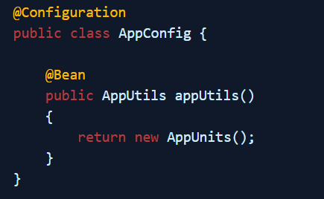
@Configuration annotation
Spring Configuration annotation indicates that the class has @Bean definition methods. So Spring container can process the class and generate Spring Beans to be used in the application.

Slide 29
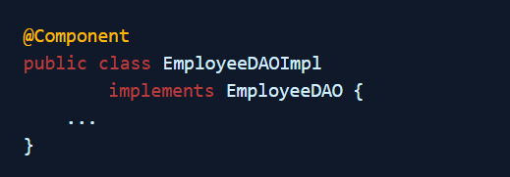
@Component annotation
This is a generic annotation and can be applied to any class of the application to make it a spring managed component(simply, generic stereotype for any spring managed component). when the classpath is scanned by the spring’s component-scan (@ComponentScan) feature, it will identify the classes annotated with @Component annotation (within the given package) and create the beans of such classes and register them in the ApplicationContext.

Slide 30
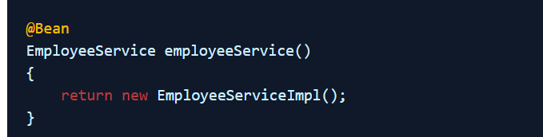
@Bean annotation
@Bean is used to explicitly declare a single bean, rather than letting Spring do it automatically as above. It decouples the declaration of the bean from the class definition, and lets you create and configure beans exactly how you choose.
Typically, @Bean methods are declared within @Configuration classes.

Slide 31
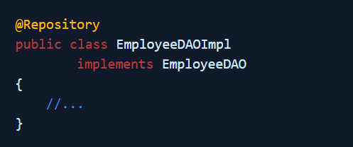
@Repository annotation
An specialization of the @Component annotation. This annotation designated the bean class as a spring managed component in the persistence layer/DAO layer. It notify the spring that the class will contain the logic for accessing the data. @Repository translates any unchecked exceptions (application specific exceptions, database-specific SQL exceptions etc…) thrown from DAO methods into Spring’s DataAccessException. (once the exception is occurred, it will communicate with PersistenceExceptionTranslationPostProcessor to translate the exception into Spring’s DataAccessException)

Slide 32
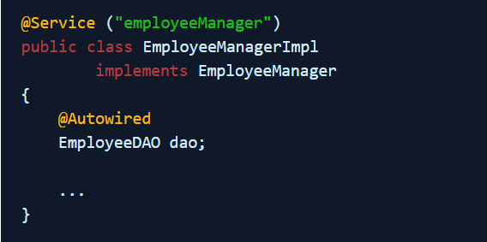
@Service annotation
An specialization of the @Component annotation. It indicates that a class is a “Business Service Facade” or something similar.It doesn’t currently provide any additional behavior over the @Component annotation.

Slide 33
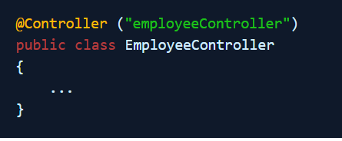
@Controller annotation
Spring Controller annotation can be applied on classes only. It’s used to mark a class as a web request handler. It’s mostly used with Spring MVC application.
We cannot switch this annotation with any other like @Service or @Repository, even though they look same. The dispatcher scans the classes annotated with @Controller and detects methods annotated with @RequestMapping annotations within them. We can use @RequestMapping on/in only those methods whose classes are annotated with @Controller and it will NOT work with @Component, @Service, @Repository

Slide 34
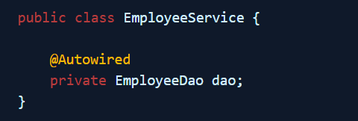
@Autowired annotation
Marks a constructor, field, setter method, or config method as to be autowired by dependency injection. We can mark whether the annotated dependency is required (mandatory to populate) or not using it’s ‘required’ attribute. By default, its value is ‘true’.

Slide 35
Bean Scopes
In Spring, scope can be defined using spring bean @Scope annotation.
singleton
prototype
request
session
application
websocket
Let’s go with an live coding examples

Slide 36
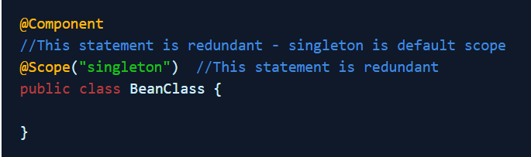
Singleton scope
singleton is default bean scope in spring container. It tells the container to create and manage only one instance of bean class, per container. This single instance is stored in a cache of such singleton beans, and all subsequent requests and references for that named bean return the cached instance.

Slide 37
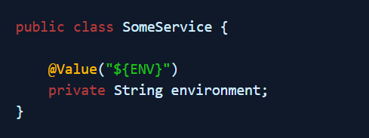
@Value annotation
Applicable at the field or method/constructor parameter level, and indicates a default value expression for the affected argument.

Slide 38
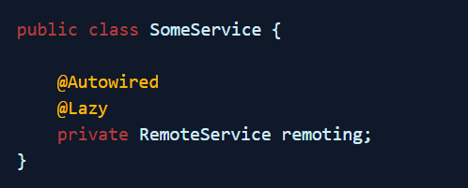
@Lazy annotation
Indicates whether a bean is to be lazily initialized. By default, in spring DI, eager initialization will occur.
When applied over any bean, initialization of that bean will not happen until referenced by another bean or explicitly retrieved from the enclosing BeanFactory.

Slide 39
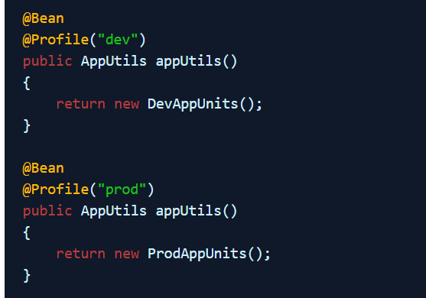
@Profile annotation
Indicates that a component is eligible for bean registration when one or more specified profiles are active. A profile is a named logical grouping of beans e.g. dev, prod etc.

Slide 40
What to try at home
Setup new Spring Boot project (https://start.spring.io/)
Create and test services with “singleton” and “prototype” scopes
Try all 3 types of dependency injection mechanisms
Try to change the component scan paths
Run the app with different configuration profiles and define different parameters for each profile

